Slide 1
A Point Set Generation Network for
3D Object Reconstruction from a Single Image
Paper by
Haoqiang Fan*
Hao Su*
Leonidas Guibas
Presentation by
Apoorva S(2019702014)
Anurag S(2018121004)
Kajal S(2019801006)
CVPR December 2016

Slide 2

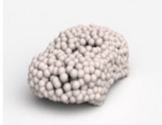
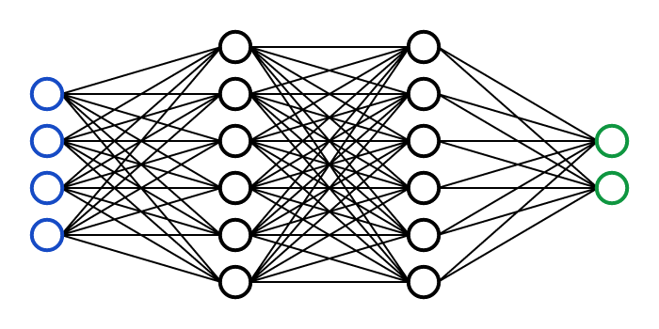
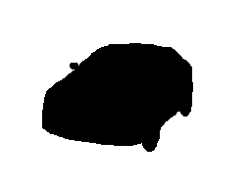
What is the project All About?
Addresses the problem of 3D reconstruction from a single image by giving 3D point cloud coordinates.
?

Slide 3
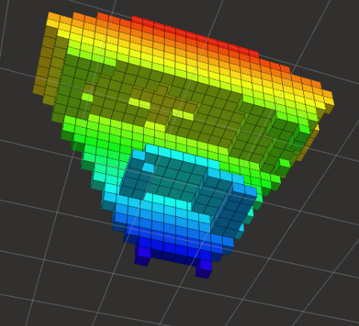
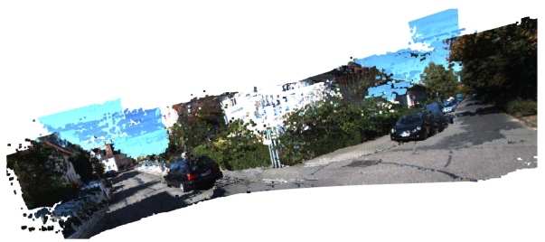
What’s New in it?
Till date, 3D representation is in the form of volumetric grids or collection of images, They suffered invariance during 3D geometric transformations.
Point cloud representation can be easily transformed geometrically as associations between the components is not required to be updated during transformations.

Slide 4
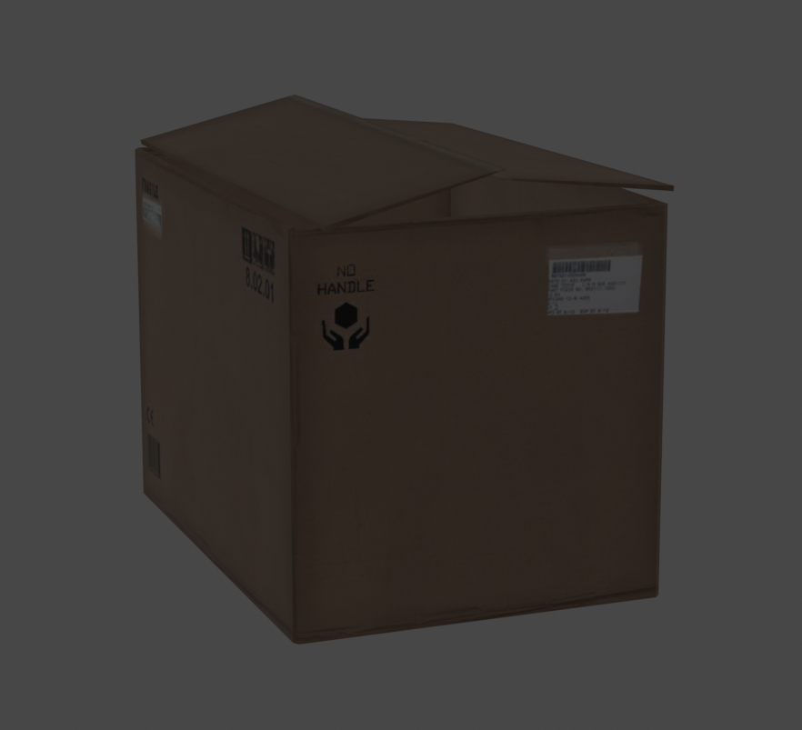
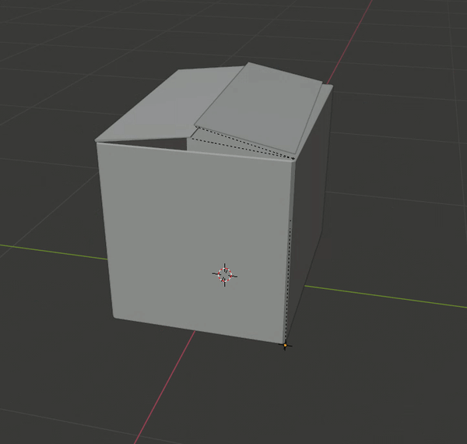
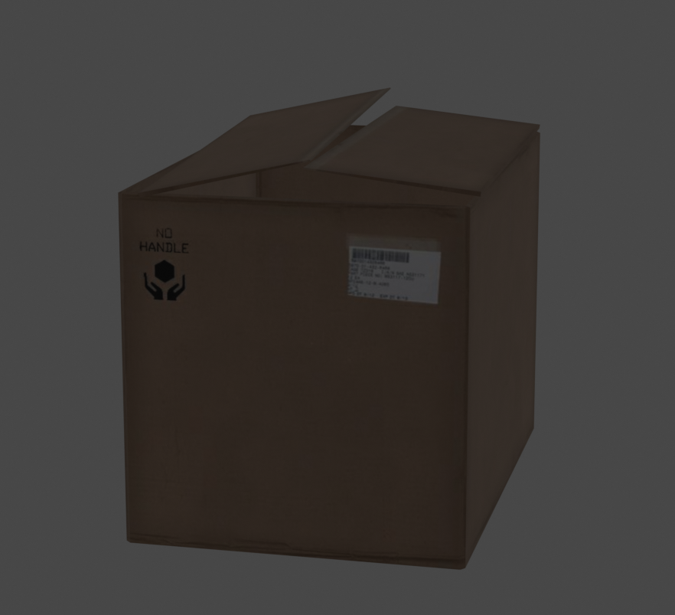
Challenges for Point Cloud Generation using Neural Networks
Neural network has to hallucinate complete 3D structure from a single view
Training problem inherently different due to ground truth ambiguity
Proper choice of loss function is crucial for meaningful results
Design architecture has to encompass the possibility of multiple outputs

Slide 5


Proposed solutions to the Challenges
The network has been designed in two ways to deal with different appearances : Vanilla Version and Two Branch Prediction
The loss function has been chosen to account for the ground truth ambiguity and give the best output from the multiple possible results obtained.
Loss function : Chamfer Distance for giving multiple possible results
Additional Loss Function: MoN Loss for choosing best out of multiple choice

Slide 6
Conditional Generative Architecture Formulation
Goal - Single 2D image (RGB or RGBD) to complete 3D shape
S = {(x_{i}, y_{i}, z_{i})}^{N}_{i=1} , N is predefined constant, N = 1024 seems sufficient
The ground truth is a probability distribution, P(./I) over the shapes possible for input, I i.e. for given image the output 3D points come with a probability
So, we train the Neural Network as a conditional sampler from P(./I)
  S = G ( I, r, θ)
  Θ - n/w parameter
  r ~ N(O, I) - It is a random variable to perturb the input

Slide 7
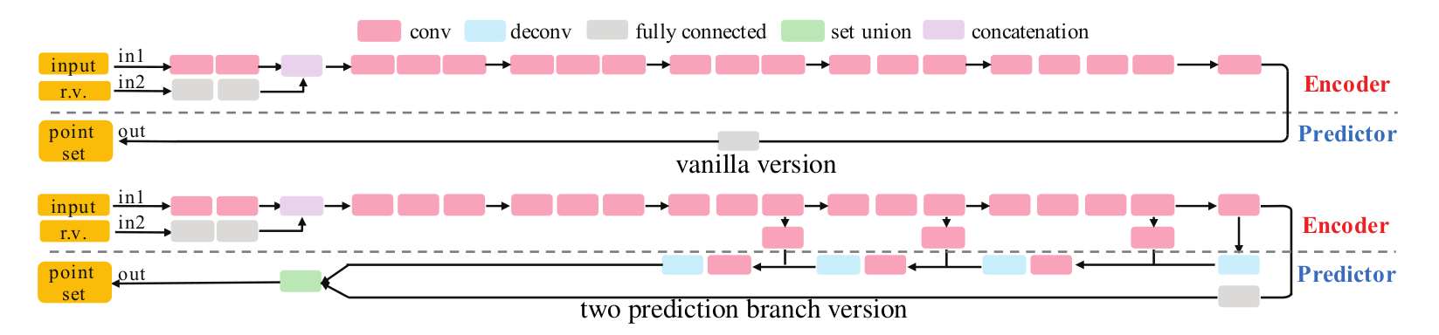
Conditional Generative Architecture

Slide 8
Experimental Details
Input Images dimension 192x256
The deconv branch produces 768 points which correspond to a 32x24 three-channel image.
The fully connected branch produces 256 points.
The training program is implemented in TensorFlow.
Adam is used as the optimizer.
Activation Function:ReLU

Slide 9
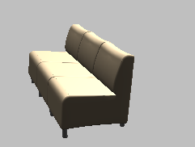
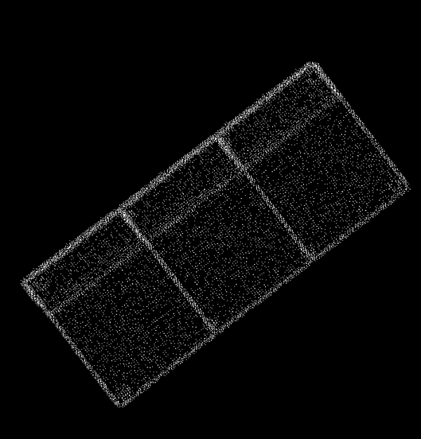
Input and Ground Truth

Slide 10
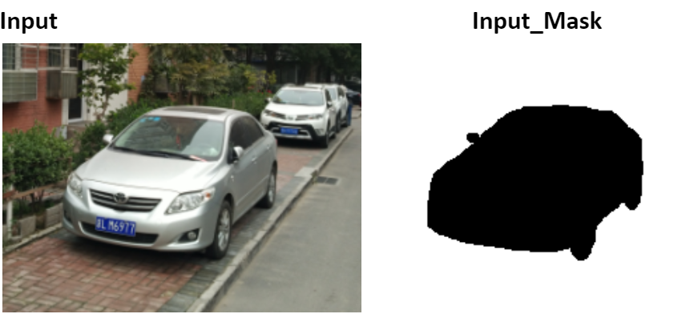
Experimental Results
Notes:
I think Code snippets must be in Experimental Details

Slide 11
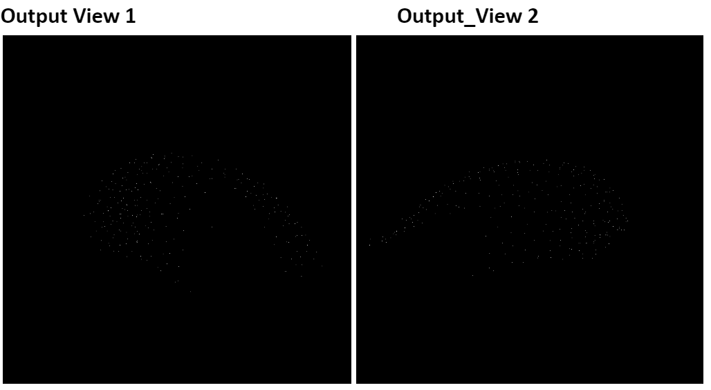

Slide 12
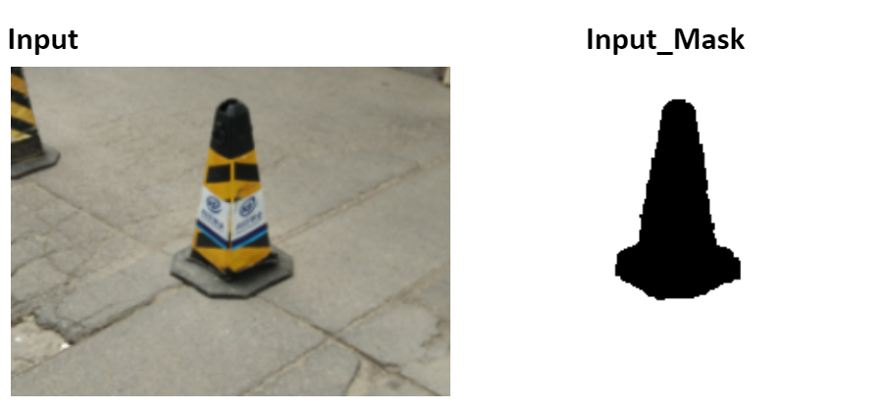

Slide 13
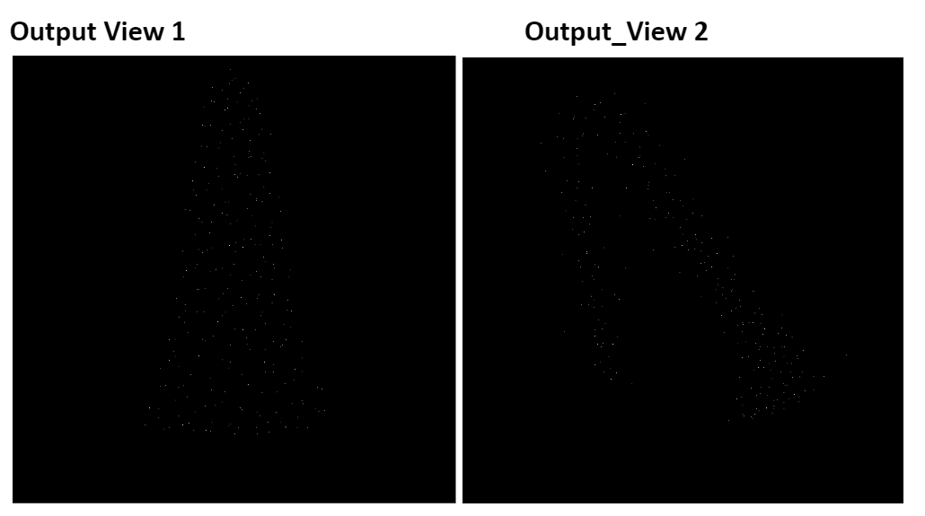

Slide 14
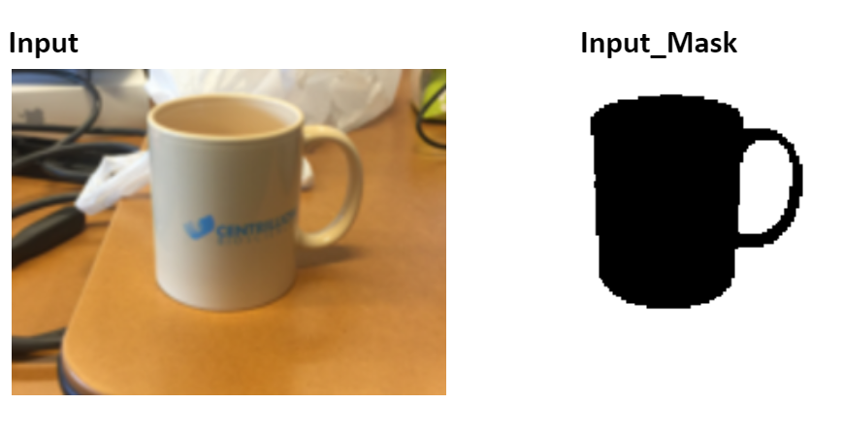

Slide 15
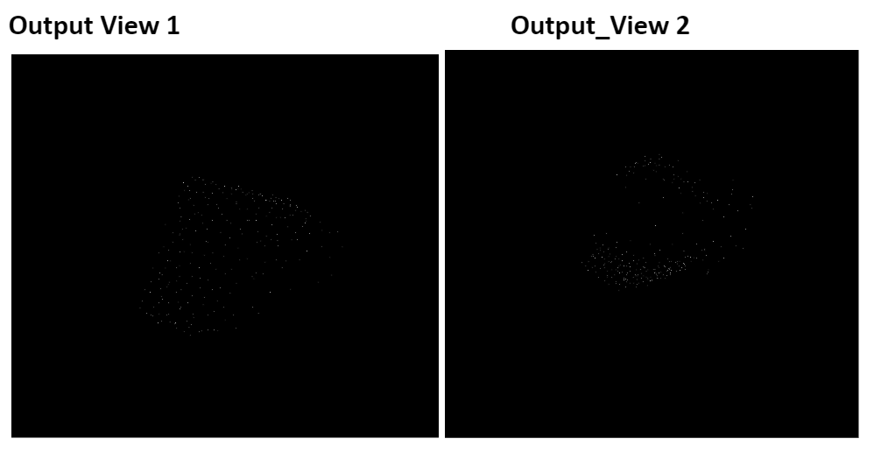

Slide 16
Expected Learnings
Learn and implement Conditional Generative Network
Understanding 3D Convolution Network
Implementation and Deployment of Neural Network
Designing and Implementation of Custom Loss functions
Working with TensorFlow and Cuda
NN’s for 3D points reconstruction from single image

Slide 17
To be continued...
Improvement of current results
Implementation of Two Branch Prediction version
Comparison of results
Testing the model on real world data

Slide 18
Important Links!
Link to Paper
State of the Art for 3D reconstruction from single Image as of 2019 Mesh R-CNN by FAIR ICCV 2019.

